Slide 1
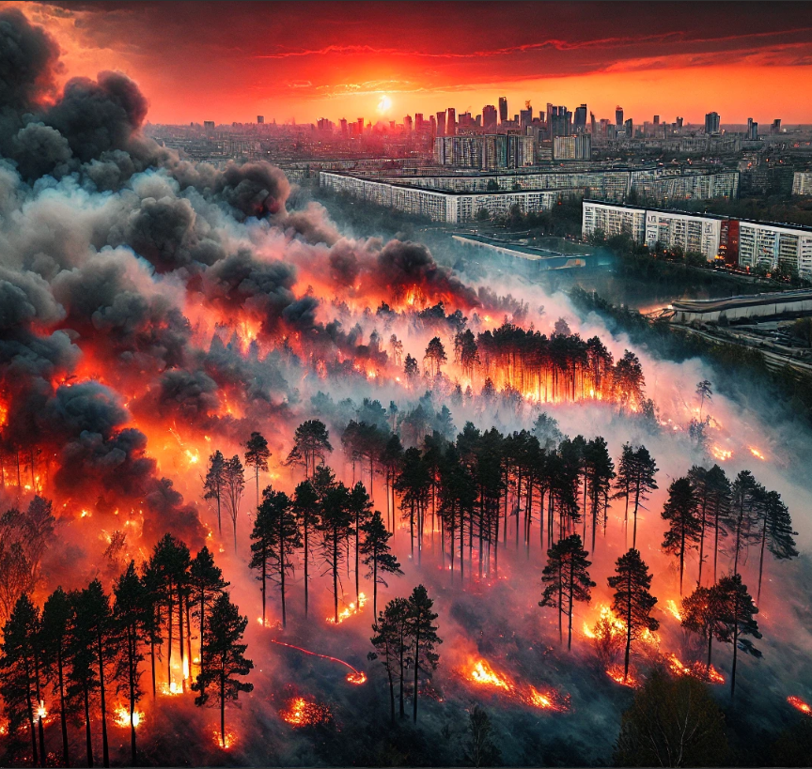
Understanding Wildfire Impact on Glendale
Analyzing Wildfire Proximity, Air Quality and Health Outcomes
Priyam Gupta
Notes:
Today, I'd like to discuss a pressing issue affecting Glendale—the impact of wildfires on our air quality and health. As wildfires become more frequent and severe, understanding how they influence our air and respiratory health is crucial. My research focuses on analyzing wildfire proximity, air quality indices, and health outcomes to provide insights that can help us better understand the problem."

Slide 2
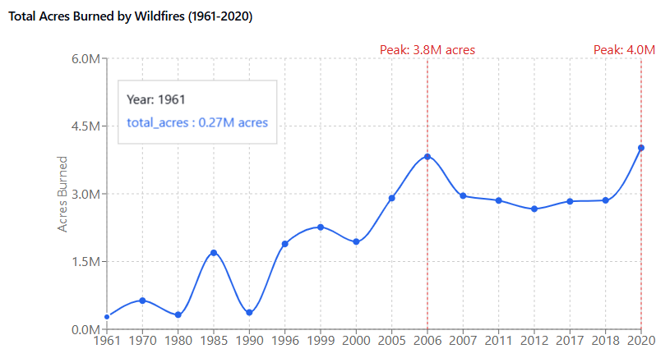
Background - The Rising Threat of Wildfires
Increasing frequency and severity of wildfires over the decades.
Notes:
- Over the past several decades, we've seen a significant increase in wildfire activity across the United States. This graph illustrates the total acres burned by wildfires from around 1960 to 2020. - Notice how the numbers remained relatively low and stable until the 1990s. - Since then, there's been a sharp upward trend, with peaks surpassing 4 million acres burned in recent years. - Factors like climate change, land management practices, and higher temperatures contribute to this alarming rise, posing greater risks to communities like ours.

Slide 3
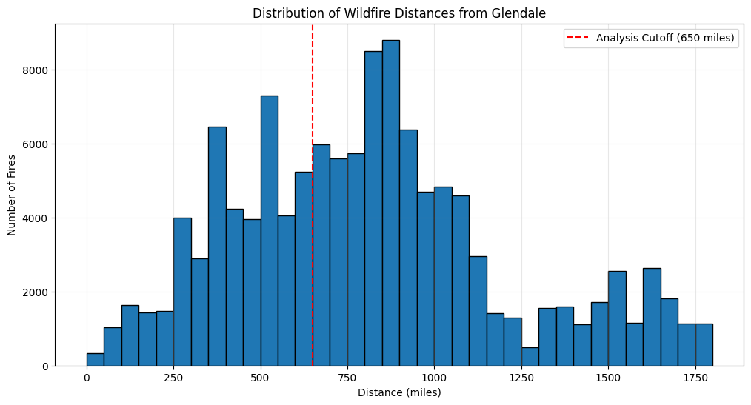
Wildfire Distribution Relative to Glendale
histogram showing the number of wildfires by distance from Glendale.
Notes:
This histogram shows the number of wildfires at various distances from the city.
You'll notice a significant concentration of fires between 250 and 1,000 miles, with a peak around 900 miles.
The red dashed line at 650 miles marks our analysis cutoff, emphasizing fires that are closer and potentially more impactful to us

Slide 4
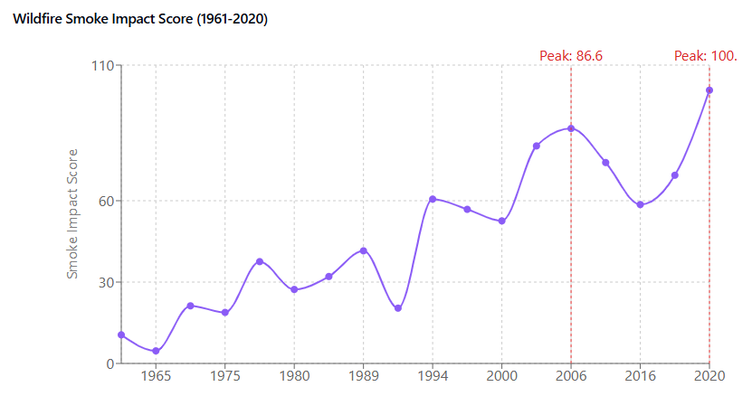
Introducing the Smoke Impact Score
Fire size (with cube-root scaling)
Distance from Glendale (with inverse-linear scaling)
Baseline impact for large fires.
Notes:
To better assess the potential impact of wildfires on our air quality, I developed a Smoke Impact Score.
This score considers both the size of the fire and its distance from Glendale.
We use an inverse-linear relationship for distance—fires within 250 miles have the maximum impact score, while those up to 650 miles gradually decrease to zero.
Fire size is scaled using a cube root to moderate extreme values, ensuring that exceptionally large fires still contribute meaningfully to the score.
This method provides a more nuanced estimation of how wildfires might affect our air quality.

Slide 5
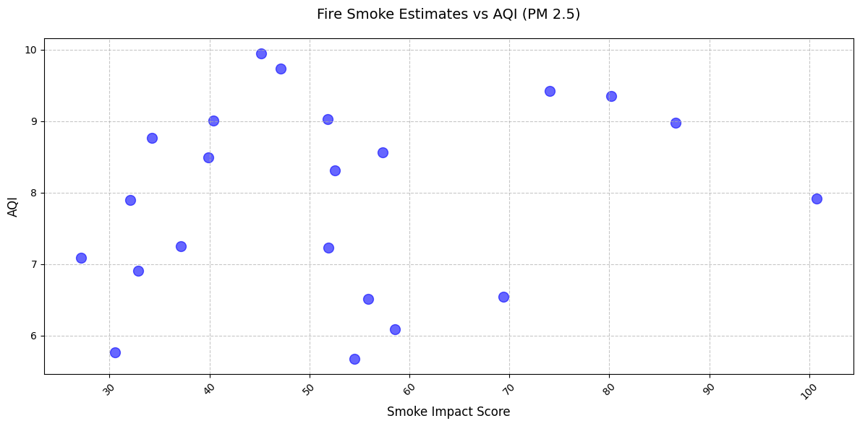
Smoke Impact Score vs. Air Quality Index
the scatter plot showing the relationship between Smoke Impact Score and AQI.
Relationship between Smoke Impact Score and AQI.
no strong linear relationship
Notes:
Here, we compare the Smoke Impact Score with the actual AQI values for PM 2.5.
As you can see, the data is quite scattered, indicating no strong linear relationship between the two.
This suggests that factors other than just fire size and distance—like wind patterns, topography, and local emissions—play significant roles in determining air quality.
While higher Smoke Impact Scores may generally align with higher AQI values, the relationship isn't direct or proportional in all cases.

Slide 6
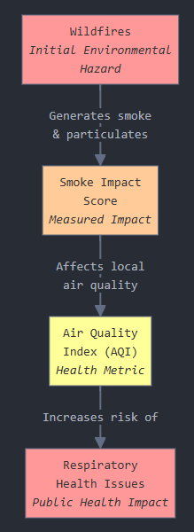
Extension Plan - Linking to Health Outcomes
Recognizing that air quality alone doesn't tell the whole story, I plan to extend my research to examine how AQI correlates with respiratory health outcomes in Glendale.
Specifically, I'll analyze hospital admission rates for conditions like asthma and bronchitis during periods of high smoke impact. By understanding this relationship, we can provide valuable insights for public health planning, resource allocation, and community advisories.

Slide 7
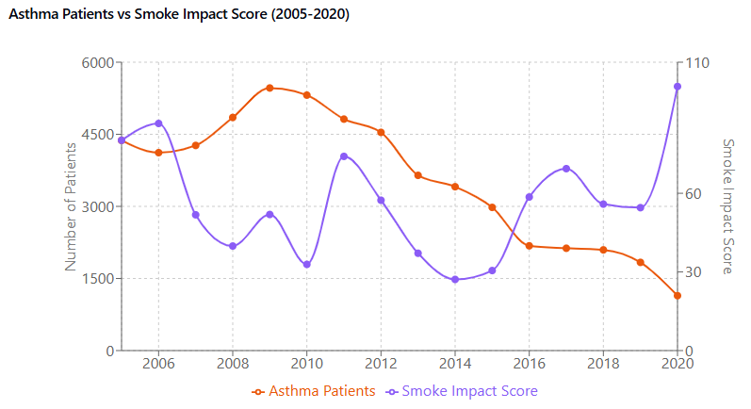
Analysis of Asthma Hospitalizations Over Time
Over the past decade. Contrary to what one might expect, the number of patients admitted has been going down.
Even as wildfires become more frequent and severe.

Slide 8
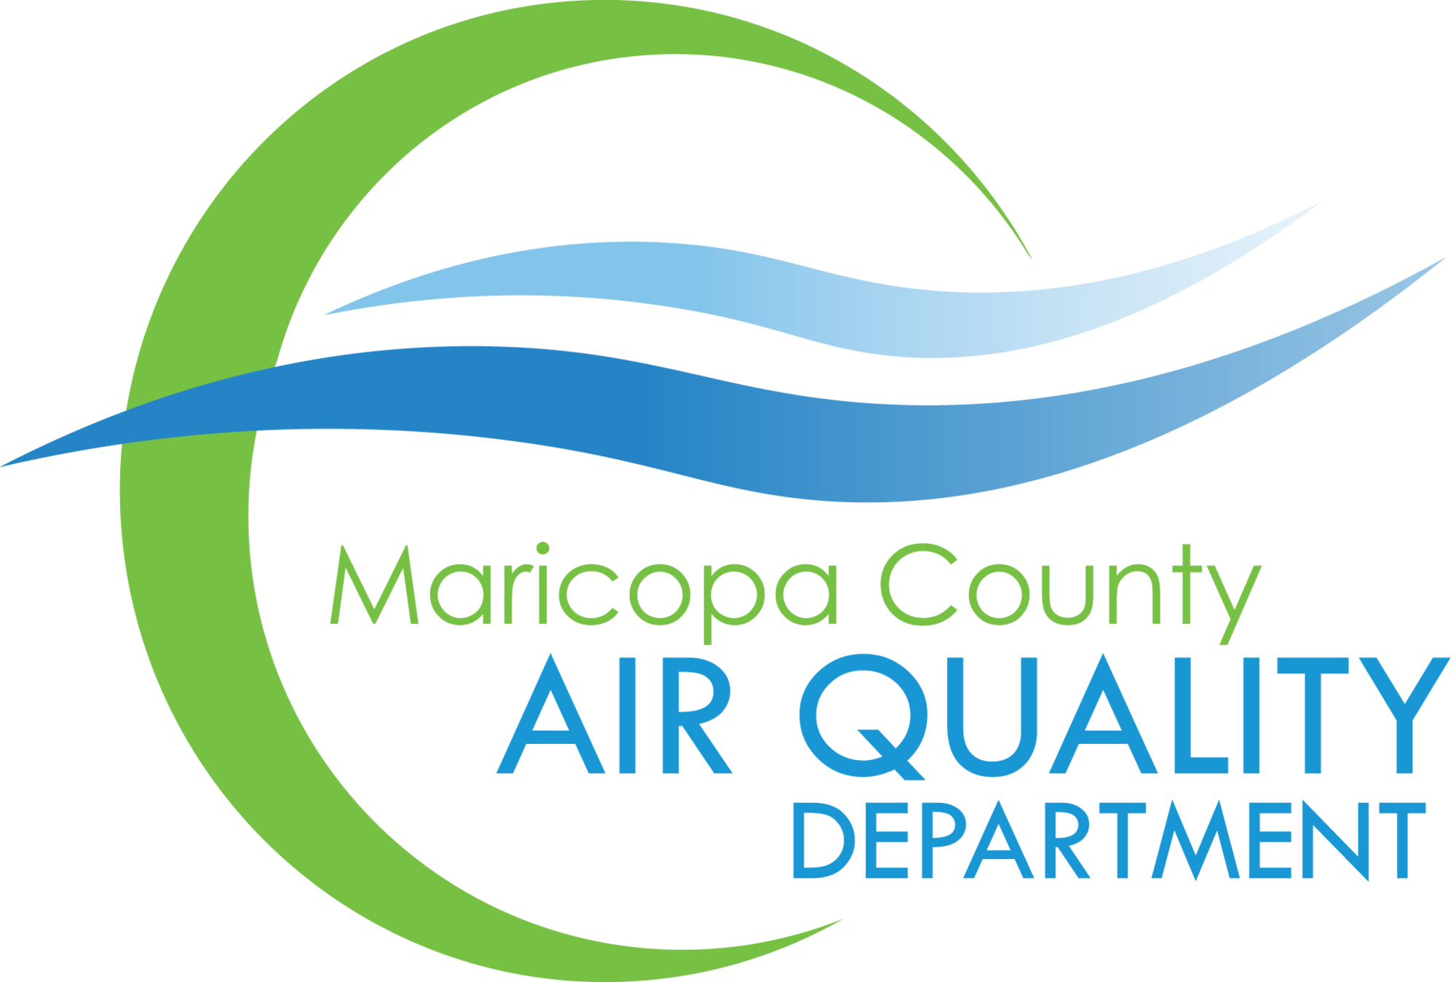

Policies leading to reduce wildfire and suggestions
Existing Policies
Camp Not-A-Wheeze Partnership
STEM kits for air quality education
Focus on clean air and asthma management for kids
Lean Air Make More Campaign
Mobile app for air quality updates
Tips for residents to improve air quality
Policy Suggestions
Implement a robust fuels reduction strategy like thinning trees
Investing watershed health restoration
Development of fire resistant landscapes

Slide 9
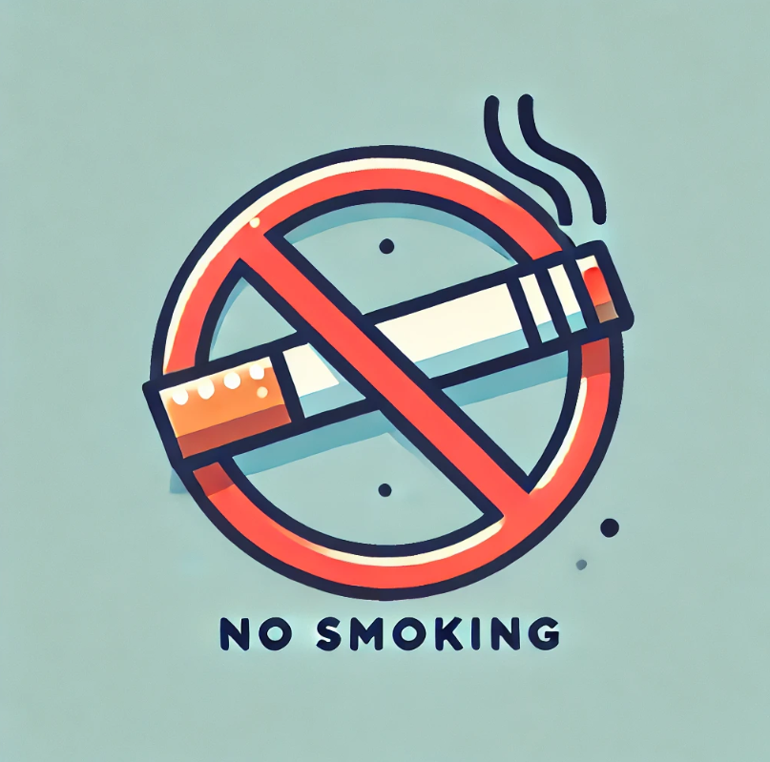
Policies and Healthcare Access in Asthma Management
Key Policies:
Smoke-Free Arizona Act (2007):
Prohibits smoking in workplaces, restaurants, bars, and other public spaces.
Reduces exposure to secondhand smoke, a major asthma trigger.
Healthcare Initiatives:
Access to Care for the Uninsured (2006):
Ensures uninsured individuals with asthma receive quality healthcare and medications.
Focuses on reducing emergency visits and hospitalizations.
Public Insurance Programs:
AHCCCS and Medicare provide critical asthma care for low-income residents.
Ongoing support aids effective asthma management.

Slide 10
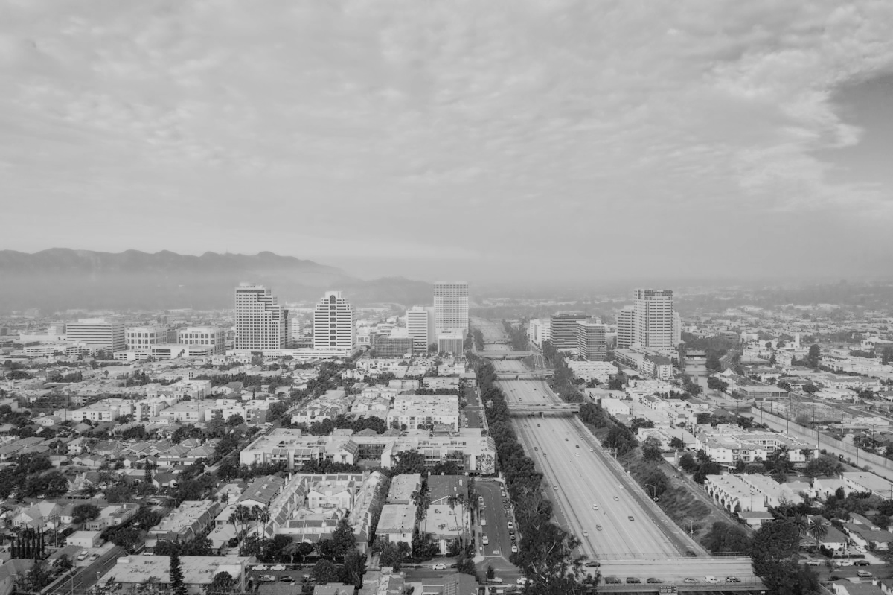
Research Conclusions and outcomes
In conclusion, while wildfires are indeed increasing and pose potential risks, Glendale's proactive approach to healthcare is yielding positive results.
The decrease in asthma hospitalizations suggests that our preventative healthcare strategies are successfully protecting residents against the adverse effects of wildfire smoke.
While the Smoke Impact Score provides a useful tool for estimating potential air quality issues, it's clear that multiple factors influence the actual conditions.
These findings are encouraging and underscore the importance of continuing to invest in and support such initiatives

